Slide 1
VL731 VLSI Architecture Design
A Highly Efficient Conditional Feedthrough Pulsed Flip-Flop for High-Speed Applications

Slide 2
Agenda
Introduction
Explaining few PFF designs and their pros
The proposed PFF and why it’s better
Simulation and results
Conclusion

Slide 3
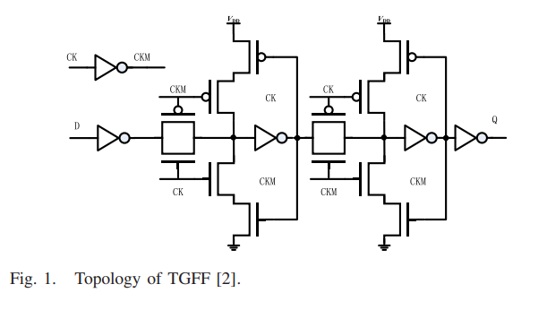
TGFF
Negative-edge triggered FF.
Clock Dependency.
2 Phase Clock system.
Timing Overhead.
2 Types of PFFs
Explicit.
Implicit.

Slide 4
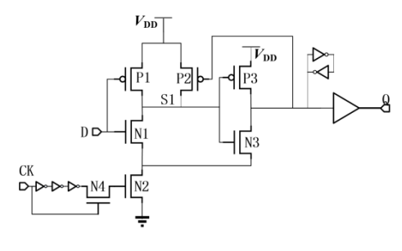
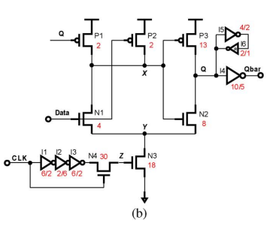
MHLFF

Slide 5
MHLFF 4 problems
Multiple inverters and a large N4 transistor are needed to form the “pulse,” thus increasing clock power.
The 0-to-1 D-to-Q delay is large because node s1 is not pre-discharged.
Node s1 begins floating when the output Q and input data both equal “1,” leading to additional dc power consumption.
When D is “1” and CK is “0,” a level uplift occurs in the output waveform due to the charge sharing in the discharge path, which causes additional power dissipation(Solved by CEPFF).

Slide 6
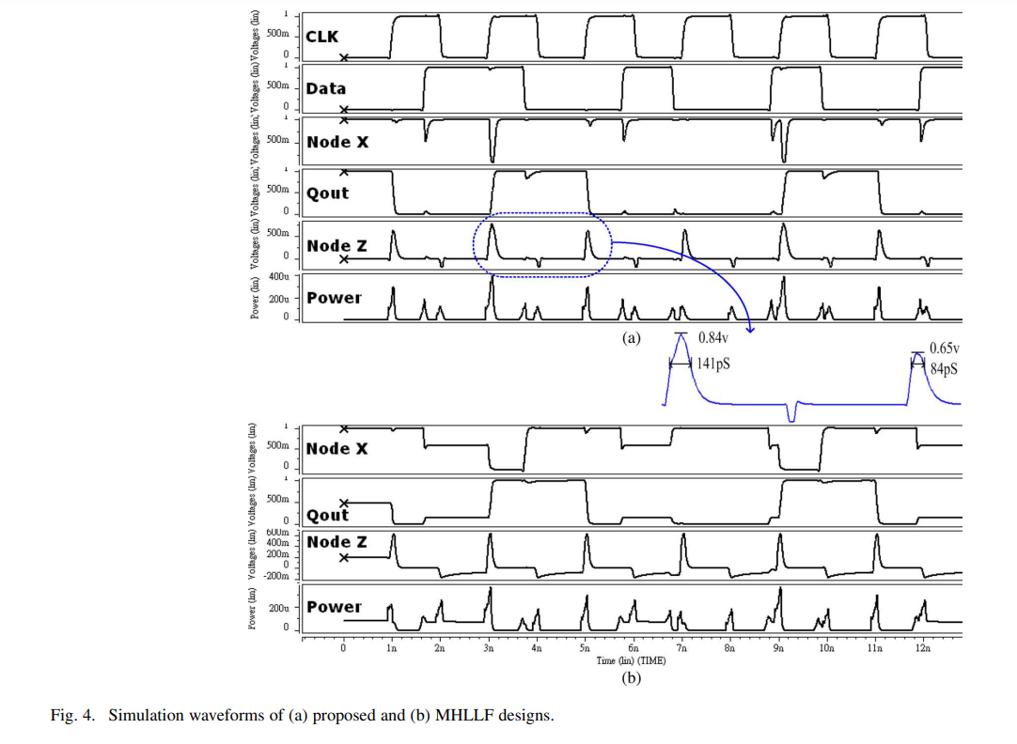
MHLFF Plots

Slide 7
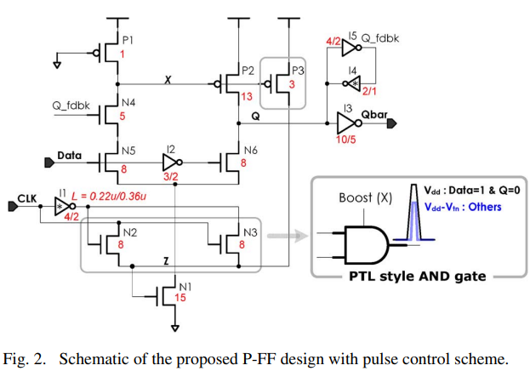
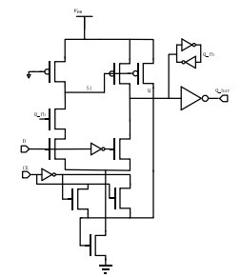
CEPFF(Solves the MHLFF Issue)

Slide 8
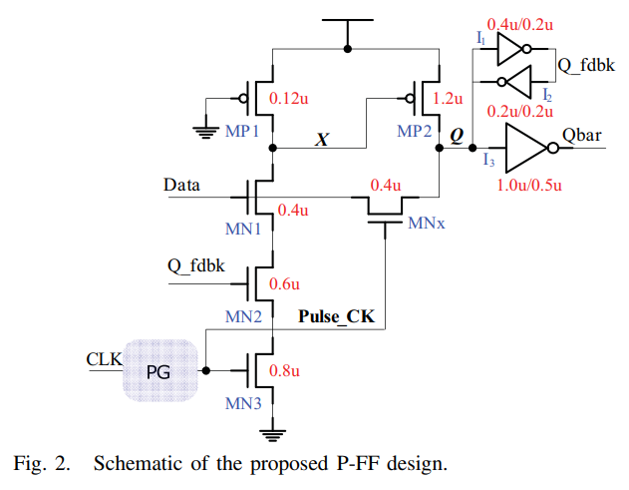
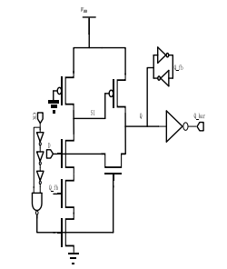
SFTPFF

Slide 9
SFTPFF
SFTPFF has advantage over CEPFF as the number of stacked transistors over the discharging path are less in number because the SFTPFF is directly controlled by the input via a pass NMOS transistor and the discharging path has that same NMOS, only one transistor while CEPFF has N1 and N6 both in the discharge path.
Degraded HIGH Logic because of the pass NMOS transistor.
Different Rise and Fall Delays.

Slide 10
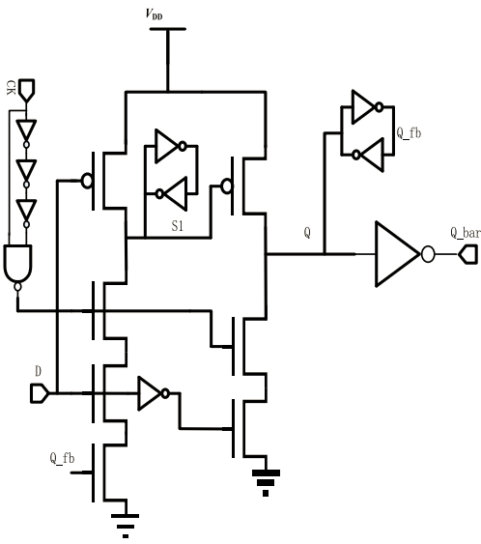
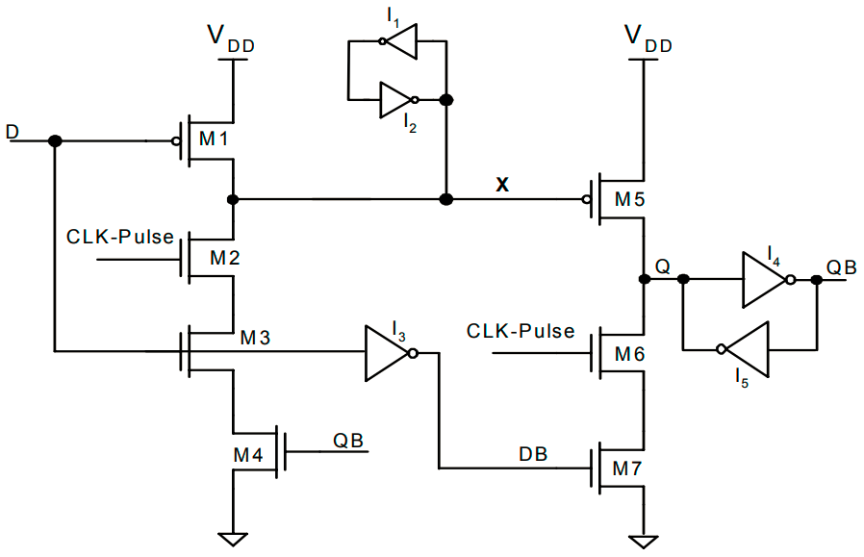
SCDFF

Slide 11
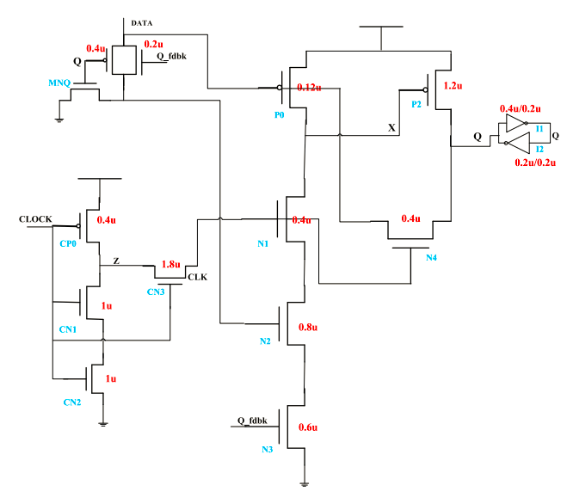
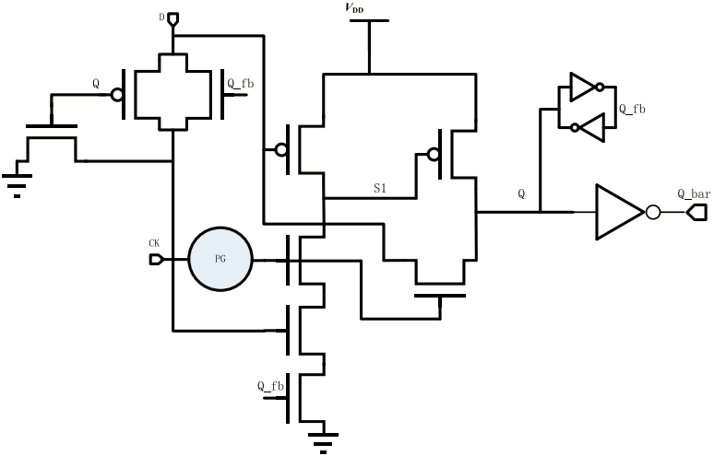
CDMPFF

Slide 12
Disadvantages in other state-of-art designs :
Larger 0-to-1 D to Q delay caused by unbalanced pull-up & pull-down path.
Delay chain-based PG, increases dynamic power along the clock path.
Unnecessary internal node switching causes additional dc power consumption.

Slide 13
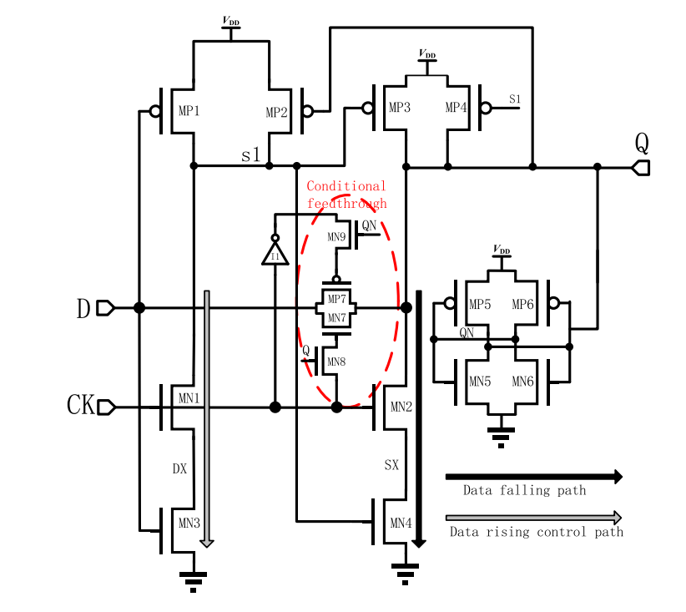
Proposed design

Slide 14
Proposed design
Data-controlled discharge(MN3) transistor is kept closer to the ground than clock-controlled discharge transistor.
Output controlled transmission gate allows input data to be fed directly through to the output (MN7, MP7, MN8 & MN9).
Added internal node-controlled (MN4) and pulse-clock controlled (MN2) discharge transistors.
Output Feedback keeper(MP2) used to avoid unnecessary internal node switching of S1.

Slide 15
Proposed design - Transistor Sizing
Three Groups :
Storage Node (MP5,MN5,MP4,MN4)
Timing Paths
Data falling path (MP1,MN2,MN4)
Data rising path (MP3,MP4,MN1,MN3)
Others (MP2, output-controlled transmission gate)

Slide 16
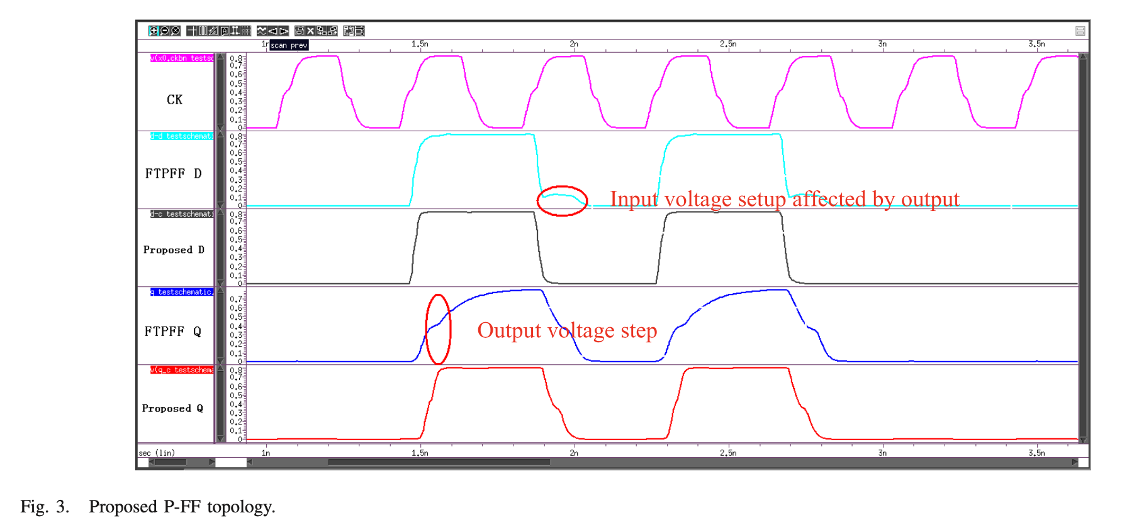

Slide 17
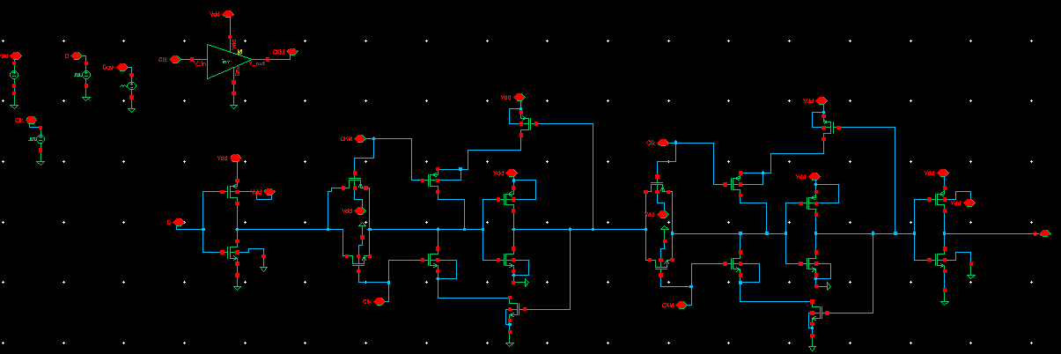
TGFF

Slide 18
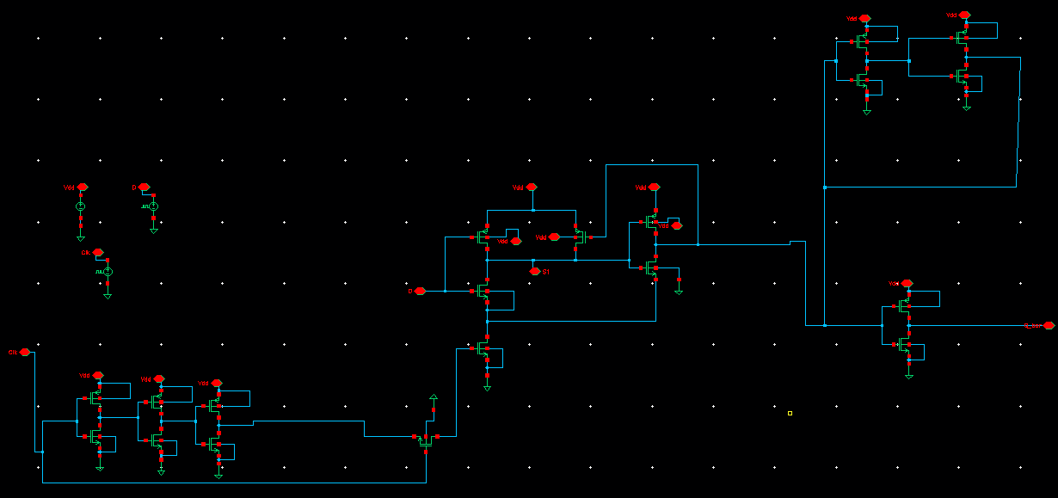
MHLFF

Slide 19
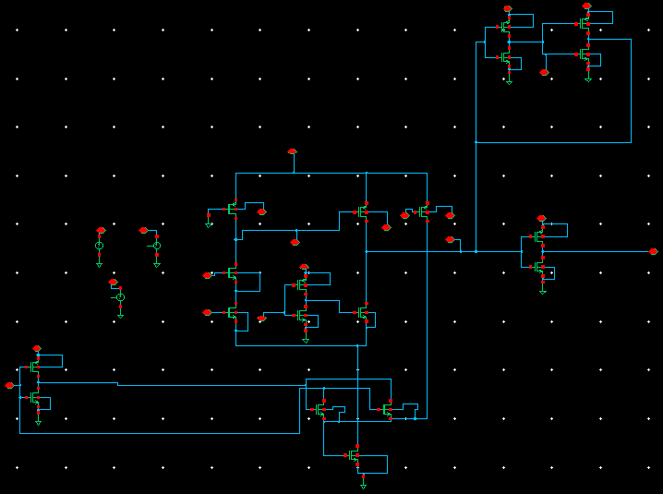
CEPFF

Slide 20
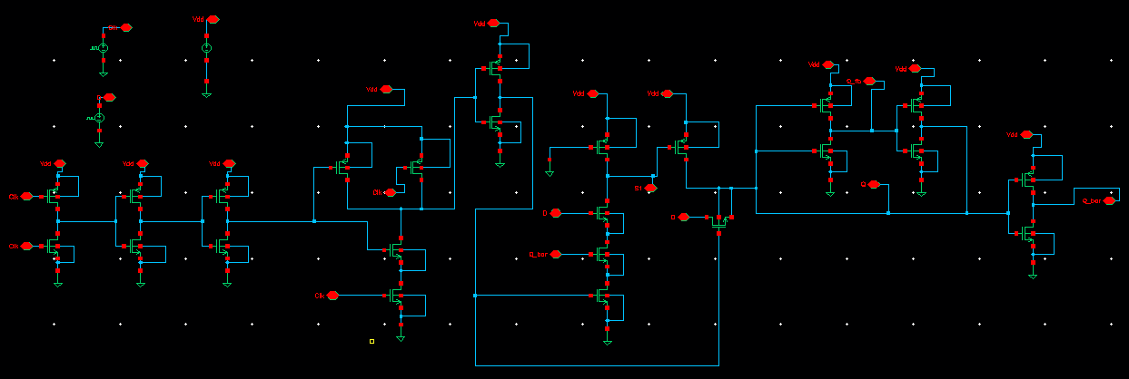
SFTPFF

Slide 21
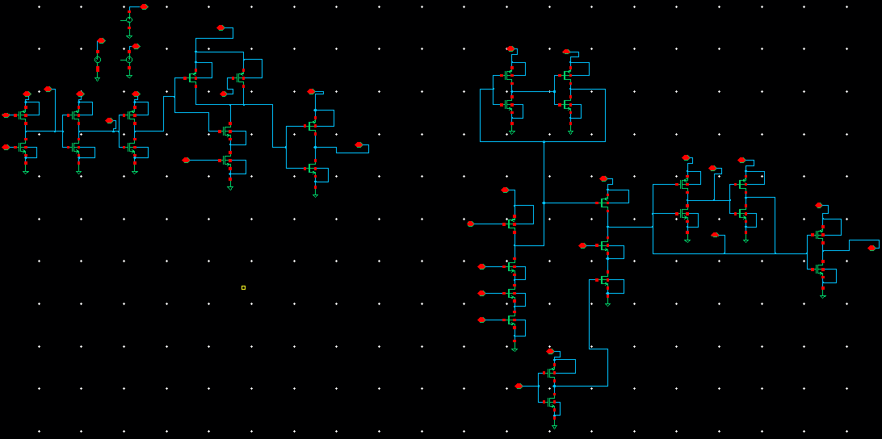
SCDFF

Slide 22
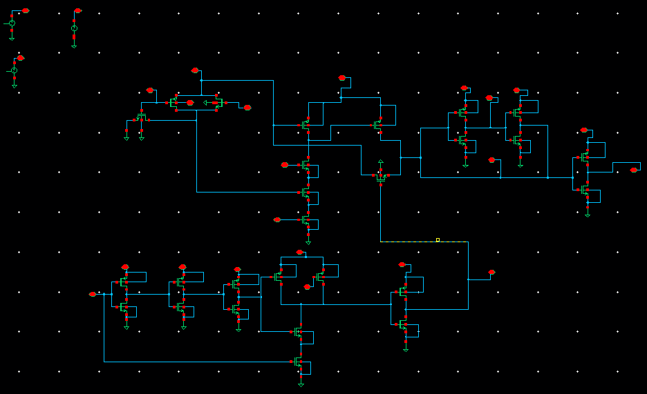
CDMPFF

Slide 23
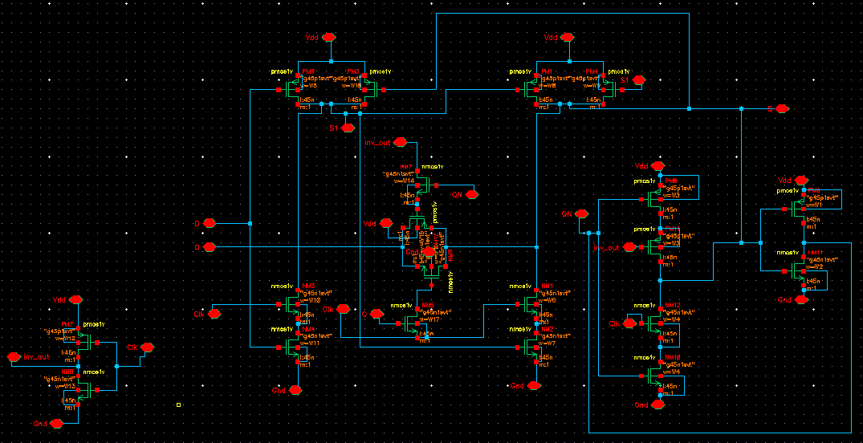
Proposed Circuit [CFTPFF]

Slide 24
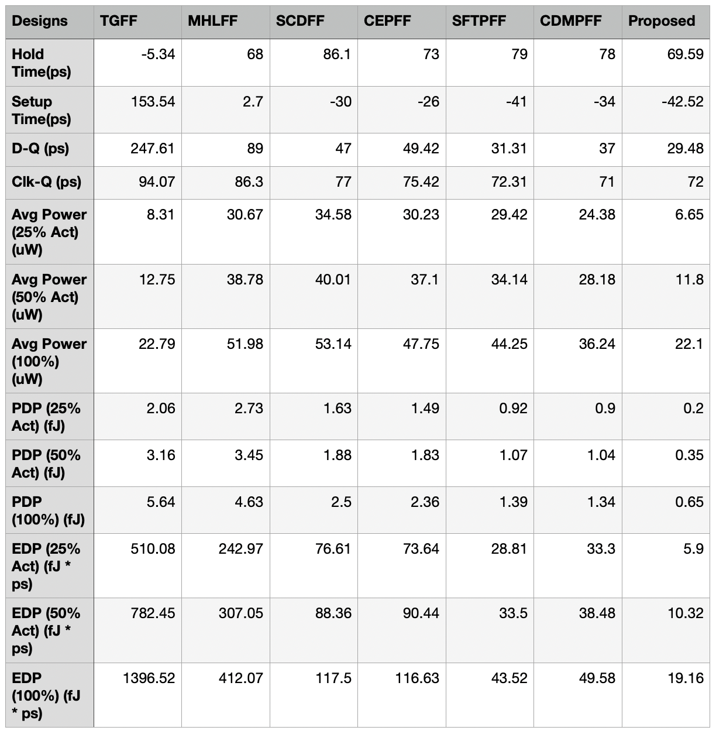
Observations

Slide 25
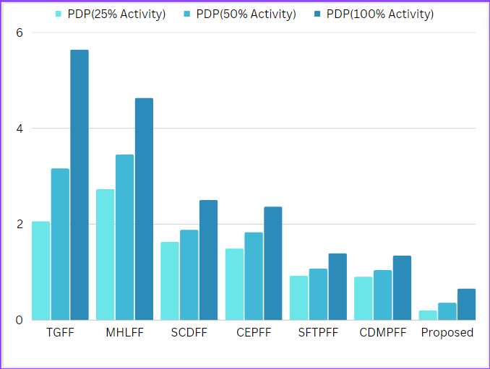
PDP Trends(fJ units)

Slide 26
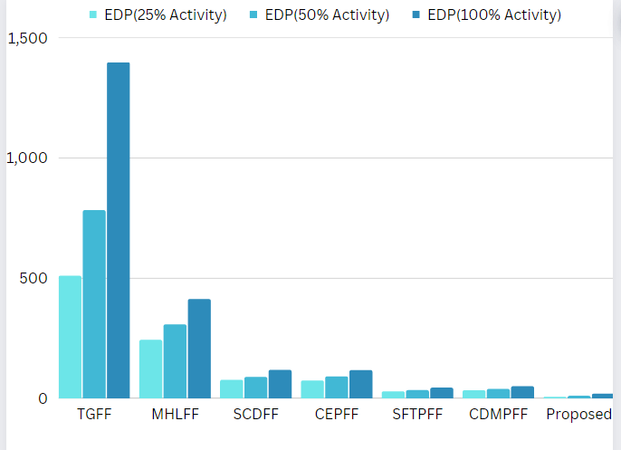
EDP Trends(fJ*ps units)

Slide 27
References
S. H. Rasouli, A. Khademzadeh, A. Afzali-Kusha, and M. Nourani, “Low-power single- and double-edge-triggered flip-flops for high speed applications,” IEE Proc.-Circuits, Devices Syst., vol. 152, no. 2, pp. 118–122, Apr. 2005. doi: 10.1049/ip-cds:20041241.
Y.-T. Hwang, J.-F. Lin, and M.-H. Sheu, “Low-power pulse-triggered flip-flop design with conditional pulse-enhancement scheme,” IEEE Trans. Very Large Scale Integr. (VLSI) Syst., vol. 20, no. 2, pp. 361–366, Feb. 2012. doi: 10.1109/tvlsi.2010.2096483.
J. F. Lin, “Low-power pulse-triggered flip-flop design based on a signal feed-through,” IEEE Trans. Very Large Scale Integr. (VLSI) Syst., vol. 22, no. 1, pp. 181–185, Jan. 2014. doi: 10.1109/tvlsi.2012.2232684.
M. W. Phyu, W. L. Goh, and K. S. Yeo, “A low-power static dual edge triggered flip-flop using an output-controlled discharge configuration,” in Proc. IEEE Int. Symp. Circuits Syst., Kobe, Japan, May 2005, pp. 2429–2432. doi: 10.1109/iscas.2005.1465116.
A. Karimi, A. Rezai, and M. M. Hajhashemkhani, “A novel design for ultra-low power pulse-triggered D-flip-flop with optimized leakage power,” Integration, vol. 60, pp. 160–166, Jan. 2018. doi: 10.1016/ j.vlsi.2017.09.002.

